Slide 1
Friend Function

Slide 2
Friend Function
The concepts of encapsulation and data hiding dictate that non-member functions should not be able to access an object’s private or protected data.
However, there are situations where such rigid discrimination leads to considerable inconvenience.

Slide 3
Friend Function
A friend function is a function that can access the non-public members of a class, even though the function itself is not a member of the class.
A friend function is a normal function with special access privileges.

Slide 4
Friend Function
A friend function of a class is a non-member function of a class that has the right to access all private and protected (non-public) members of the class.
Friend function prototype should be placed inside the class definition (can be any where inside the class definition).
Friend function definition should be outside the class scope.
Even though the prototypes of friend functions appear in the class definition, friends are not member functions.

Slide 5
A friend function of a class can be a
  function (non-member of a class)
  member function of another class
  function template
To declare a function as a friend of a class, precede the function prototype in the class definition with keyword friend.
Friend functions are used in Operator overloading to increase the versatility of operators.

Slide 6
General Syntax
class ClassName {
...... .... ........
friend returnType functionName( arguments ); // friend function declaration
...... .... ........
};
// friend function definition does not start with friend keyword
returnType functionName( arguments ) {
…. …. ….
// private and protected data of the above class can be accessed from this function
…. …. …. }
int main( ) { ….
functionName( arguments ); // Call to the friend function
…..}

Slide 7
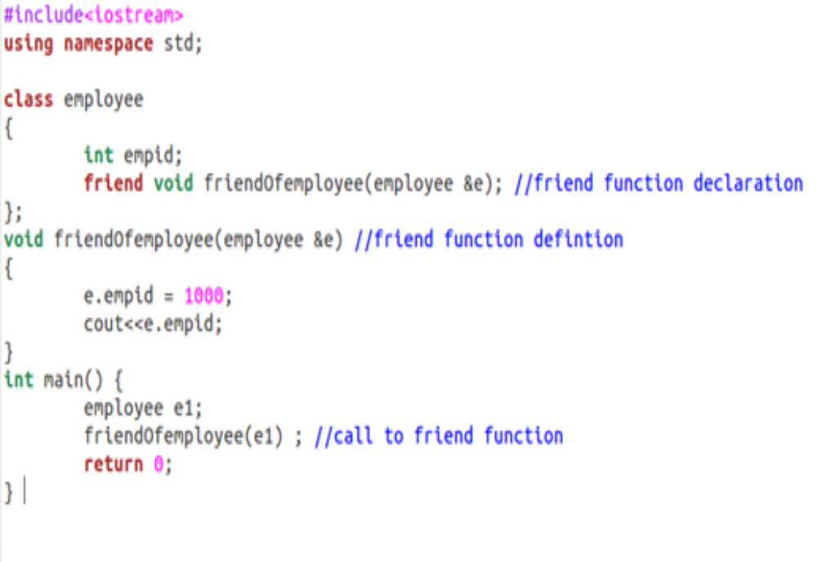
Sample Program 1

Slide 8
Difference between Friend function and Member function
Member Function | Friend Function
It is invoked through an object | Not invoked through an object since it is a non-member of a class If the friend function of class X is a member function of class Y, then it must be invoked through an object of class Y
Can access the non-public members of the class directly | Can access the non-public members of the class only through an object (since this pointer is not visible)

Slide 9
#include <iostream>
class A {
int a;
public:
A() { a = 0; }
// global friend function
friend void showA(A&);
};
void showA(A& x)
{
// Since showA() is a friend, it can access
// private members of A
std::cout << "A::a=" << x.a;
}
int main()
{
A a;
showA(a);
return 0;
}
A simple and complete C++ program to demonstrate global friend
Output:
A::a = 0

Slide 10
A simple and complete C++ program to demonstrate friend function of another class
#include <iostream>
class B;
class A {
public:
void showB(B&);
};
class B {
private:
int b;
public:
B() { b = 0; }
friend void A::showB(B& x); // Friend function
};
void A::showB(B& x)
{
// Since showB() is friend of B, it can
// access private members of B
std::cout << "B::b = " << x.b;
}
int main()
{
A a;
B x;
a.showB(x);
return 0;
}
Output:
B::b = 0

Slide 11
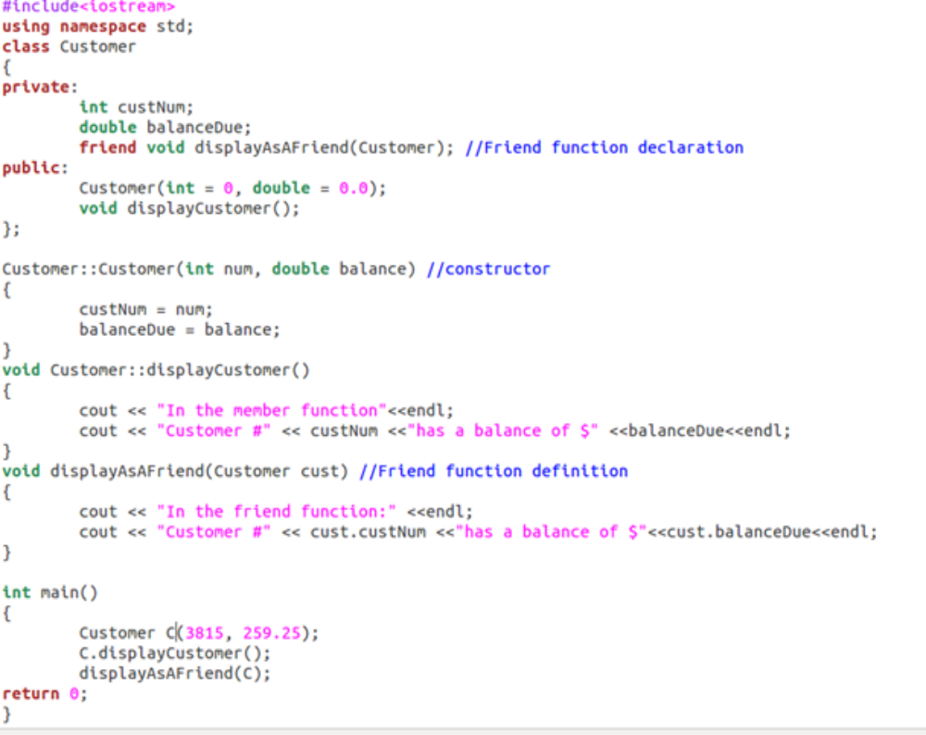
Sample Program 2

Slide 12
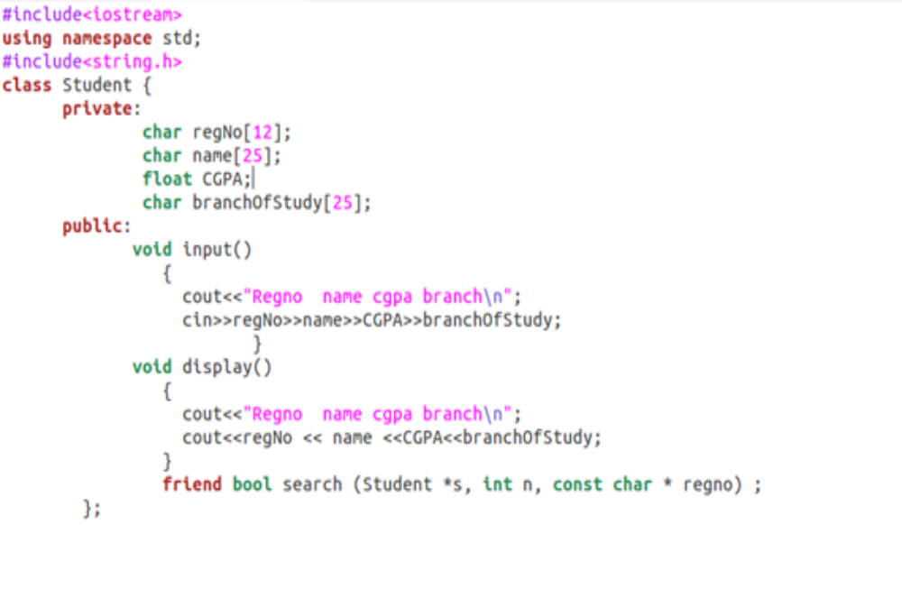
Sample Program 3

Slide 13
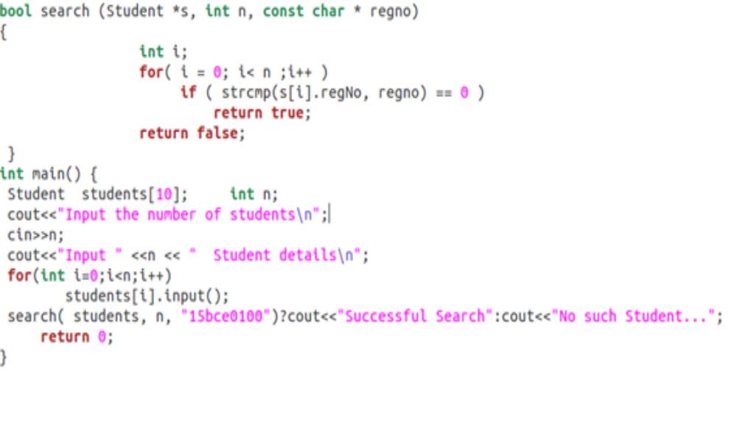

Slide 14
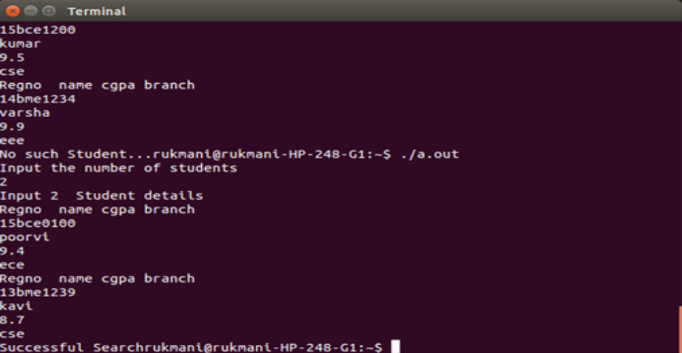

Slide 15
Friend Class
Friend Class A friend class can access private and protected members of other class in which it is declared as friend. It is sometimes useful to allow a particular class to access private members of other class. For example, a LinkedList class may be allowed to access private members of Node.

Slide 16
class Node {
private:
int key;
Node* next;
/* Other members of Node Class */
// Now class LinkedList can
// access private members of Node
friend class LinkedList;
};

Slide 17
#include <iostream>
Using namespace std
class A {
private:
int a;
public:
A() { a = 0; }
friend class B; // Friend Class
};
class B {
private:
int b;
public:
void showA(A& x)
{
// Since B is friend of A, it can access
// private members of A
cout << "A::a=" << x.a;
}
};
int main()
{
A a;
B b;
b.showA(a);
return 0;
}
Output:
A::a=0

Slide 18
// C++ program to demonstrate the working of friend class
#include <iostream>
using namespace std;
// forward declaration
class ClassB;
class ClassA {
private:
int numA;
// friend class declaration
friend class ClassB;
public:
// constructor to initialize numA to 12
ClassA() : numA(12) {}
};
class ClassB {
private:
int numB;
public:
// constructor to initialize numB to 1
ClassB() : numB(1) {}
// member function to add numA
// from ClassA and numB from ClassB
int add() {
ClassA objectA;
return objectA.numA + numB;
}
};
int main() {
ClassB objectB;
cout << "Sum: " << objectB.add();
return 0;
}

Slide 19
Friends to more than One Class Act as Bridges
Imagine that you want a function to operate on objects of two different classes.
Perhaps the function will take objects of the two classes as arguments, and operate on their private data. Here’s a simple example, that shows how friend functions can act as a bridge between two classes.

Slide 20
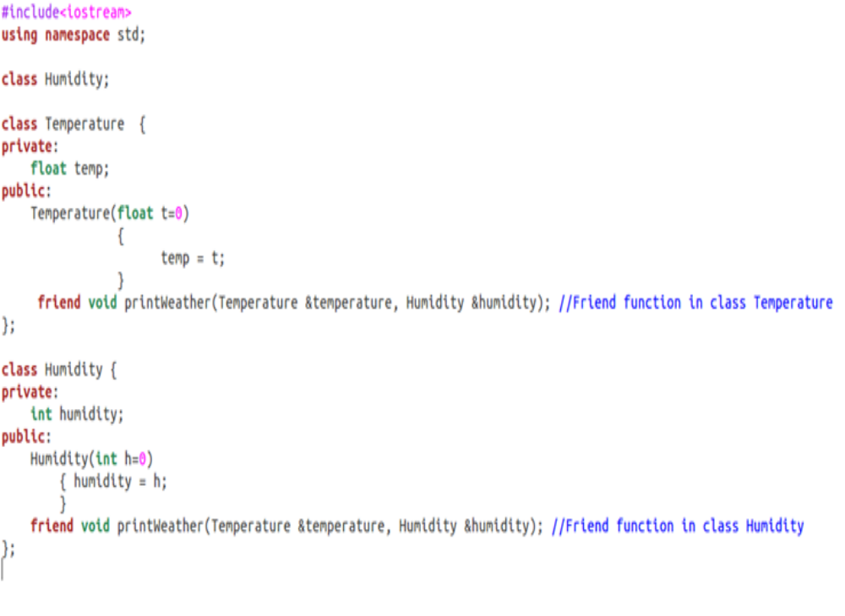

Slide 21
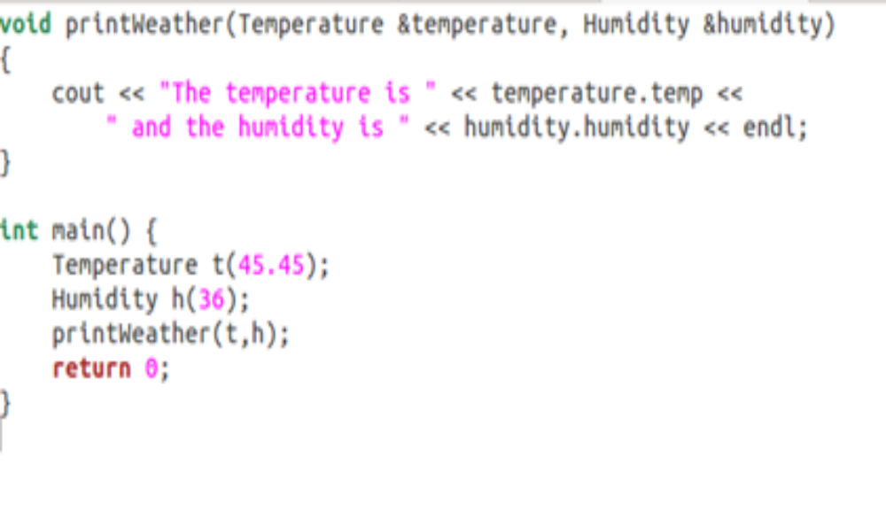

Slide 22
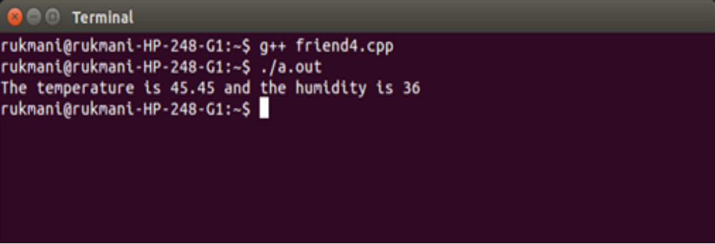

Slide 23
Additional Materials

Slide 24
Breaching the Walls
Friend function violates the concepts of data hiding, the philosophy that only member functions can access a class’s private data.
How serious is the breach of data integrity when friend functions are used?
A friend function must be declared as such within the class whose data it will access. Thus a programmer who does not have access to the source code for the class cannot make a function into a friend.
In this respect, the integrity of the class is still protected.
Friend functions are conceptually messy, and potentially lead to a spaghetti-code situation if numerous friends muddy the clear boundaries between classes.
For this reason friend functions should be used sparingly. If you find yourself using many friends, you may need to rethink the design of the program.

Slide 25
Friend Function – Member Function of a class
#include <iostream>
using namespace std;
class Distance
{
private:
int meter;
public:
/* Distance()
{
meter=0;
}*/
void get()
{
cin>>meter;
}
friend int addFive(Distance);
};
int addFive(Distance d)
{
d.meter += 5;
return d.meter;
}
int main()
{
Distance D;
D.get();
cout<<"Distance: "<< addFive(D);
return 0;
}

Slide 26
Friend Function – Member Function of another class
#include <iostream>
using namespace std;
class B;
class A {
private:
int x;
public:
A()
{
x=12;
}
friend int add(A, B);
};
class B {
private:
int y;
public:
B()
{
y=1;
}
friend int add(A , B);
};
int add(A a, B b)
{
return (a.x + b.y);
}
int main()
{
A a;
B b;
cout<<"Sum: "<< add(a,b);
return 0;
}

